Slide 1
Lecture 7: State-Space Modeling
Introduction to state-space modeling
Definitions
How it relates to other modeling formalisms
State-space examples
Transforming between model types

Slide 2
State-Space Modeling
A state-space model represents a system by a series of first-order differential state equations and algebraic output equations
State-space models are numerically efficient to solve, can handle complex systems, allow for a more geometric understanding of dynamic systems, and form the basis for much of modern control theory

Slide 3
Example
Consider the following system where u(t) is the input and is the output
Can generate a state-space model by pure mathematical manipulation by changing variables

Slide 4
Example (continued)
System has 1 input (u), 1 output (y), and 3 state variables (x₁, x₂, x₃)
state
equations
output
equation

Slide 5
State-Space Modeling
In general state-space models have the following form (equations can be nonlinear and time varying)
state
equations
output
equations

Slide 6
State-Space Modeling
For linear systems, can write as matrices
For our prior example

Slide 7
State-Space Modeling
There is a more intuitive way to find state-space models
Recall the difference between static and dynamic models
Static system – current output depends only on current input
Dynamic system – current output depends on current and past inputs (can be captured by initial conditions)
input
SYSTEM
output

Slide 8
State-Space Modeling
Question: What initial conditions do I need to capture the system’s state?
Definition: the state of a dynamic system is the smallest set of variables (called state variables) whose knowledge at t = t₀ along with knowledge of the inputs for t ≥ t₀ completely determines the behavior of the system for t ≥ t₀
# of state variables = # of independent energy storage elements

Slide 9
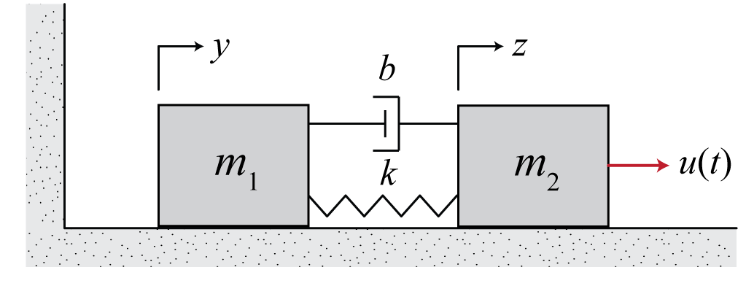
Example
One choice of
state variables:
Equations of motion:

Slide 10
Example
Rather, look at where energy is stored
Energy Storage Element State Variable
spring (stores elastic PE)
mass 1 (stores KE)
mass 2 (stores KE)
damper does not store energy, it dissipates energy
Also, choice of state variables is not unique

Slide 11
Example

Slide 12
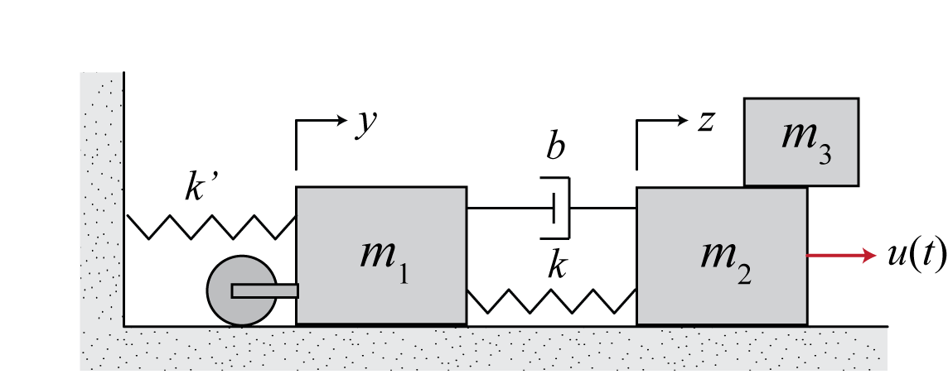
Example
# of state variables ≠ # of energy storage elements if:
Some elements are constrained together (dependent)
Some equations cannot be expressed in terms of the minimum # of state variables

Slide 13
Transforming Between Model Types
State space to transfer function

Slide 14
Example

Slide 15
Transforming Between Model Types
Note, poles (roots of the denominator) can be found from
poles of transfer function = eigenvalues of A
From transfer function to state space
The state-space form is not unique, so there are many choices (transfer function is unique)
Look up a form in a book

Slide 16
Summary of Model Forms
State space/differential equations (time domain)
Numerically efficient to solve, simulate
Can include initial conditions
Can model nonlinear, time-varying, MIMO systems
Facilitates a geometric interpretation of systems
Difficult to see output behavior from inspection
Transfer function (frequency domain)
Algebraic representation
Easy to connect components
Can use frequency response techniques
Cannot include initial conditions
Can only model LTI, SISO systems

